Slide 1
CLOUD INTRODUCTION
-- Suresh Siripuram
Notes:
Welcome to Module 1, Section 1 – Cloud Concepts Overview.

Slide 2
AGENDA
What is Cloud Computing?
Types of Clouds?
Advantages of Cloud Computing?
Service Modules in Cloud?
What is Amazon Web Services (AWS)?
Cloud Vs On-premises.
Regions & Availbility Zones & Edge Loactions.
Enterprises that uses Aws.
Domain of Services.
Notes:
In this module, we are going to discuss the basics of cloud computing. In part one, you’ll learn what cloud computing is. In part two, you’ll discover the six advantages of cloud computing. In part three, we’ll reveal what Amazon Web Services is, and in part four, you’ll discover the AWS Cloud Adoption Framework.
This course assumes that you have a non-IT background, as it will not teach you how to build applications in the cloud. This course will give you a general conceptual understanding about the cloud and AWS.

Slide 3

What is Cloud Computing?
In simple terms, Cloud computing is technology where resources is provided as a service through internet to a user with pay-as-use pricing.
Notes:
Cloud computing is the on-demand delivery of compute power, database storage, applications, and other IT resources through a cloud services platform via the internet, with pay-as-you-go pricing.
The most basic way to define what the “cloud” is that it is a computer located somewhere else that is accessed via the Internet and utilized in some way. Web services is also another name for what people call the cloud.
The cloud is comprised of server computers located in large data centers in different locations around the world. When you use a cloud service like Amazon Web Services (AWS), you are utilizing the computers owned by AWS. AWS is a cloud services provider.
The computers contain various technology features and services, like building blocks, that can be used to assemble solutions that help a user meet their business goals and technology requirements. With cloud computing, organizations can consume on-demand computing and storage resources rather than building, operating, and improving infrastructure on their own.
Visit the link to learn more
https://aws.amazon.com/what-is-cloud-computing/.

Slide 4
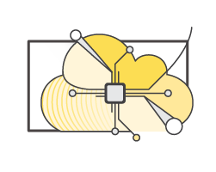
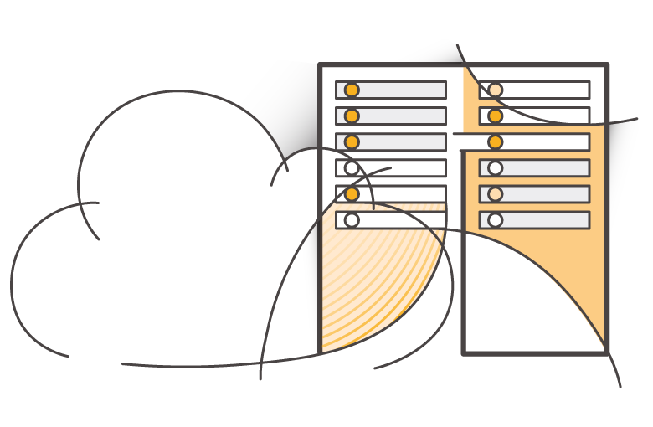

Three Cloud Deployment Models
PUBLIC CLOUD
Hybrid
Private Cloud
(On-premises)
Notes:
Now, let’s reveal the three cloud deployment models.
"All-In" Cloud is a cloud-based application that is fully deployed in the cloud, and all parts of the application run in the cloud. Applications in the cloud have either been created in the cloud or have been migrated from an existing infrastructure. Cloud-based applications can be built on low-level infrastructure pieces (for example, networking, compute or storage) or can use higher-level services that provide abstraction from the management, architecting, and scaling requirements of core infrastructure.
A hybrid deployment is a way to connect infrastructure and applications between cloud-based resources and existing resources that are not located in the cloud. The most common method of hybrid deployment is between the cloud and existing on-premises infrastructure (sometimes called on-prem). On-premises infrastructure is located within the physical confines of an enterprise, often in the company's data center. A hybrid deployment model is used to extend an organization's infrastructure into the cloud while connecting cloud resources to an internal system. For more information on how AWS can help you with your hybrid deployment, visit the link https://aws.amazon.com/enterprise/hybrid/.
When you run a cloud infrastructure from your own data center, that’s called on-premises or private cloud. While this kind of deployment lacks many of the benefits of cloud computing, it does provide dedicated resources and is a popular choice for organizations who need to meet certain compliance standards. In most cases, this deployment model is the same as legacy IT infrastructure while using application management and virtualization to increase resource utilization.

Slide 5
Three Models of Cloud Computing
IaaS
Infrastructure as a Service
PaaS
Platform as a Service
SaaS
Software as a Service
Notes:
Cloud services can fall into one of three primary categories, based mainly around how much control and responsibility you have over how the service is configured.
With IaaS (or Infrastructure as a Service), you manage the server, which can be physical or virtual, as well as the operating system (Windows or Linux). In general, the data center provider has no access to your server.
Basic building blocks for cloud IT include:
Networking features
Compute, and
Data storage space
With PaaS (or Platform as a Service), someone else manages the underlying hardware and operating systems. This enables you to run applications without managing underlying infrastructure (for example -- patching, updates, maintenance, hardware and operating systems). PaaS also provides a framework for developers that they can build upon to create customized applications.
With SaaS (or Software as a Service), you manage your files, while the service provider takes care of all of the data centers, servers, networks, storage, maintenance, patching, etc. All you worry about is the software and how you want to use it. You are provided with a complete product that is run and managed by the service provider. Facebook and Dropbox are examples of SaaS. You manage your Facebook contacts and Dropbox files, and the service providers manage the systems.

Slide 6
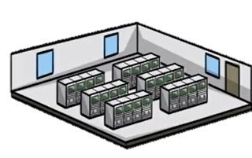
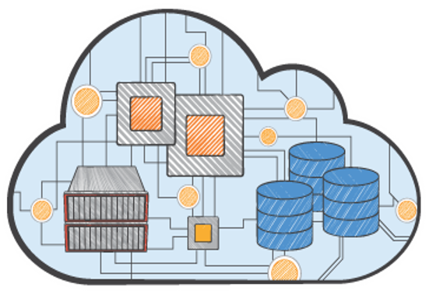
All-In Cloud versus On-Premises
All-In Cloud
No upfront investment
Focus on innovation
Flexible capacity
Global reach on demand
On-Premises
Large initial investment
Focus on Infrastructure & Maintenance
Fixed capacity
Limited geographic regions
Notes:
To summarize:
With the All-In solution, there is no upfront investment, so you avoid the large capital purchases required for an On-Premises solution. You have immediate access to resources without having to procure, install, and configure cabling, racks, servers, and storage in a physical location with appropriate facilities like cooling and power. Instead, you just click to order and pay for the resources you need, which are available almost immediately.
Cloud computing helps you reduce ongoing IT costs in multiple ways. AWS continually lowers prices due to massive economies of scale and continual improvements. Multiple pricing options also help you optimize costs based on your unique workloads. You pay only for what you use on a variable, monthly basis. On-premises solutions typically require upgrades on 1-year, 3-year, or 5-year cycles.
Cloud gives you managed IT resources on demand, at a fraction of the cost of traditional infrastructure. This cost savings empowers organizations to shift resources toward innovative new projects that grow their business by focusing on “apps not ops.”
Predicting how customers are going to adopt your new application is complex, making it difficult to estimate your infrastructure capacity needs. Flexible capacity means that your resources are dynamic. You can quickly provision resources as demand goes up and turn off what you don’t need as demand declines.
Cloud computing’s speed and agility makes it possible for you to respond to changing market conditions. With AWS, resources can be provisioned as needed. This self-service environment changes how you develop and deploy applications, allowing your team to experiment more quickly and more frequently. The amount of time it takes to get a server procured, delivered, and running limits this in a traditional infrastructure.
With on-premises, it is hard to deliver great performance to a distributed user base. The initial purchase is large, it’s labor intensive with patches, upgrade cycles and systems administration with fixed capacity. There are long procurement cycles and setup, so companies focus on one geographic region at a time to save costs and time. Without geographical limitations, you can deploy your application in any of the AWS regions around the world with lower latency and at minimal cost.

Slide 7

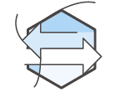
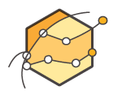



Advantages:
 | User-Friendly with GUI.
 | Security is the Upper Most priority.
 | Eliminate guessing on your capacity needs.
 | Increase speed and agility.
 | Stop spending money to run and maintain data centers.
 | Go global in minutes.
Notes:
The six benefits discussed in this section provide a strong value proposition for moving to the cloud. Each of these benefits should be considered when deciding between an on-premises or cloud solution.
For more information, visit the link. https://d1.awsstatic.com/whitepapers/aws-overview.pdf.

Slide 8












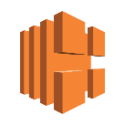












AWS Core Services: The Basics
Compute
Networking
Storage
Database
Amazon EC2
AWS Lambda
Amazon VPC
Amazon Route 53
Amazon S3
Amazon Glacier
Amazon RDS
Amazon DynamoDB
Auto Scaling
AWS Elastic Beanstalk
Amazon CloudFront
Amazon EBS
AWS Direct Connect
Elastic Load Balancing
Amazon Redshift
AWS Database Migration Service
Amazon Elastic Container Registry
Amazon Elastic Container Service
Amazon Elastic File System
AWS Snowball
Amazon ElastiCache
Amazon
Lightsail
AWS Batch
Storage
Gateway
AWS Snowmobile
Notes:
The array of AWS services can be intimidating as you start your journey into the cloud. Initially, you only need to focus on a few ”core” services. You will need to understand the AWS Global Infrastructure, several Compute services, Networking & Content Delivery, Storage, Databases, Security & Identity Access Management, and, finally, Management Tools. Specifically, you should understand the following services from the core service group:
• Compute -- including Amazon Elastic Compute Cloud (or Amazon EC2), AWS Lambda, and AWS Elastic Beanstalk.
• Networking -- including Amazon Virtual Private Cloud (or VPC), Amazon Route 53, and Domain Name Services.
• Storage -- including Amazon S3 (or Simple Storage Service), and Amazon Glacier.
• Databases -- including Amazon RDS (or Relational Database Service), and Amazon DynamoDB (or Non-Relational Database).

Slide 9
















Core Services: The Basics
 |  | Management Tools |  | Security & Identity
 |  | Amazon CloudWatch | AWS CloudFormation | AWS Identity and Access Management |  | AWS Directory Service
 |  | AWS CloudTrail | AWS Config | Amazon Inspector |  | AWS CloudHSM
 |  | AWS OpsWorks | AWS Service Catalog | AWS Key Management Service |  | AWS WAF
 |  | AWS Trusted Advisor
AWS
Organizations
AWS Certificate Manager
AWS
Shield
Notes:
From the Developer and Operations group, you should also understand the following:
• Management Tools including CloudWatch and AWS CloudFormation.
• Security and Identity -- including AWS Identity and Access Management (IAM)

Slide 10
Thank you
Notes:
Thanks for participating!

